Slide 1
Final Project Presentation: Financial Tracking & Product and Customer Analysis Report
Data-Driven Insights for Business Optimization
Ebunoluwa Salami
TEAM PHOENIX
Date: 23rd October, 2024

Slide 2
Executive summary
The Adventure Works Sales and Customer Analysis project addresses the company's need to optimize sales and improve customer satisfaction by providing a data-driven approach to understanding sales patterns, customer behavior, and product performance. The current analytical framework lacks the depth required to reveal hidden correlations and predictive trends that could significantly inform decision-making and strategy formulation. This analysis aims to bridge that gap through a comprehensive evaluation of the available data.
The project focused on several key objectives:
1. Identifying Sales Trends: Sales data was analyzed to identify patterns over time, including peak periods and seasonal sales variations.
2. Understanding Customer Behavior: By examining customer demographics and purchasing trends, key segments and behaviors were identified, enabling more targeted marketing efforts.
3. Evaluating Product Performance: Products were assessed to determine which items are best-sellers and which underperform, providing insights for inventory and product strategy adjustments.
4. Analyzing Territorial Differences: Regional sales performance was compared to pinpoint high and low-performing areas, allowing for territory-specific strategy development.
5. Seasonal Impact Analysis: Seasonal trends' effects on sales were evaluated to help optimize product offerings throughout the year.
6. Optimizing Sales Strategies: Data insights were used to recommend strategies that could boost sales and revenue.
7. Enhancing Product Offerings: Product optimization suggestions were made based on sales performance and customer preferences.
The analysis has provided Adventure Works with actionable insights that will not only improve sales strategies and marketing efforts but also refine the company's product portfolio, ultimately driving growth and customer satisfaction across its diverse market segments.

Slide 3
Project Objectives
Objective 1: Analyze product and customer data to identify top-performing products, customer segments, and regional trends.
Objective 2: Track financial metrics to understand revenue, profit, and cost trends over time.
Objective 3: Provide actionable recommendations to improve business performance, enhance customer experience, and optimize inventory management.

Slide 4
Data Sources and Methodology
Data Sources:
SQL databases containing sales, customer, and financial information.
Data Collection Process:
The data was exported in csv format from the SQLite database. Data was cleaned, being uploaded to the power query, to ensure data integrity. Accuracy of data types were effected.
Tools Used:
Power BI for data visualization.

Slide 5
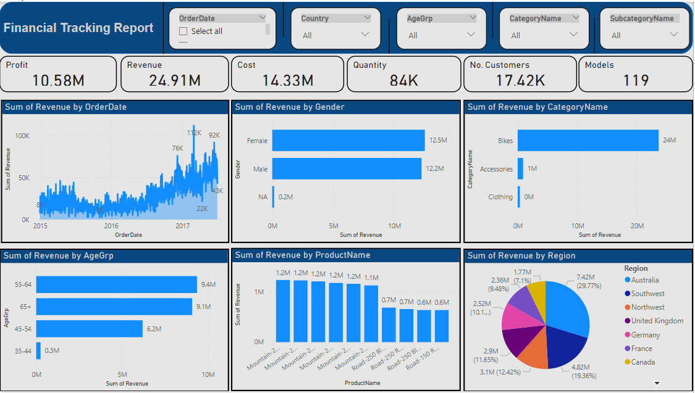
Financial Tracking
Key Metrics: visualized with cards
Profit: $10.58M
Revenue: $24.91M
Cost: $14.33M
Total Quantity Sold: 84K
Number of Customers: 17.42K
Insights:
Revenue trend over time, showing a significant increase in 2017.
Gender-based revenue distribution, indicating a balanced revenue contribution from male and female customers.
Revenue contribution by category, with bikes as the leading category.
Revenue distribution by age group, revealing higher revenue from the 55-64 age range.
Top revenue-generating products, with consistent performance from Mountain Tires.
Regional revenue analysis, showing Southwest as the top revenue contributor.

Slide 6
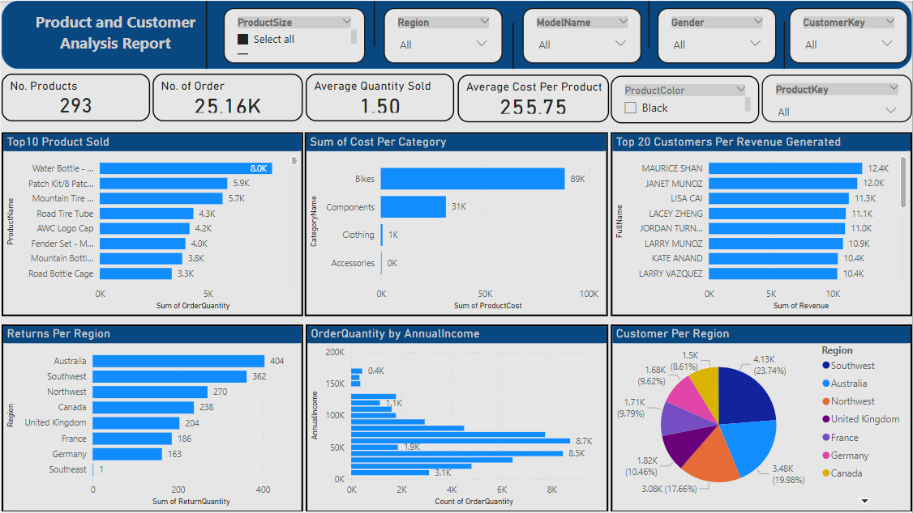
Product and Customer Analysis
Key Metrics:
Total Products: 293
Total Orders: 25.16K
Average Quantity Sold: 1.50
Average Cost per Product: $255.75
Insights:
The top 10 products sold, with Water Bottle being the highest-selling item.
Cost distribution across different categories, with bikes having the highest cost.
Customer revenue generation, with the top 20 customers contributing significantly to revenue.
Regional return analysis, identifying areas with the highest returns (e.g., Australia and Southwest).
Order quantity distribution based on annual income levels.
Customer distribution across regions, indicating high concentration in Southwest and Northwest.

Slide 7
Key Findings
Product Performance:
Certain products drive most sales, indicating the need for targeted promotions.
High return rates in some regions may indicate quality or fulfillment issues.
Customer Insights:
A significant portion of revenue is generated by a few customers, suggesting a need for customer loyalty programs.
Revenue distribution varies significantly across regions and age groups.
Financial Trends:
Revenue growth trend indicates a positive market response, particularly in 2017.
The balanced revenue between genders suggests targeted marketing campaigns may benefit different demographics.

Slide 8
Recommendations
Improve Inventory Management:
Focus on stocking top-selling products and reducing inventory for low-performing items.
Address return issues in high-return regions to improve profitability.
Enhance Customer Engagement:
Develop loyalty programs for high-revenue customers to increase retention.
Implement targeted marketing for high-potential age groups (e.g., 55-64).
Optimize Regional Strategies:
Increase focus on high-revenue regions (Southwest) while addressing issues in lower-performing areas.
Sales Promotions and Discount Strategies:
Offer seasonal discounts for categories with high seasonal sales (e.g., bikes).

Slide 9
THANK YOU

